Slide 1
My journey towards the world of data science
Data Science Capstone Project – IBM
- Sagnik Kundu

Slide 2
Executive summary
I discovered an interest in data science and enrolled in the IBM data science course to learn programming, statistics, and machine learning. I built practical skills by working on projects throughout the course, made mistakes, and learned from them. Through the IBM program's hands-on experience, I transitioned from academic learning to solving real-world problems with messy data and business constraints. Eventually, I accumulated enough skills and experience to become a professional data scientist, ready to tackle complex challenges in the field.

Slide 3
Introduction
When I first heard about data science, I was intrigued by the idea of extracting meaningful insights from data to solve real-world problems. Like many students, I wasn't sure where to start or what the path would look like. That's when I discovered the IBM Data Science Professional Certificate course, which became the foundation of my transformation from a curious student into a confident data scientist. This is the story of how I navigated the challenges, built essential skills, and ultimately launched my career in one of today's most exciting and dynamic fields.

Slide 4
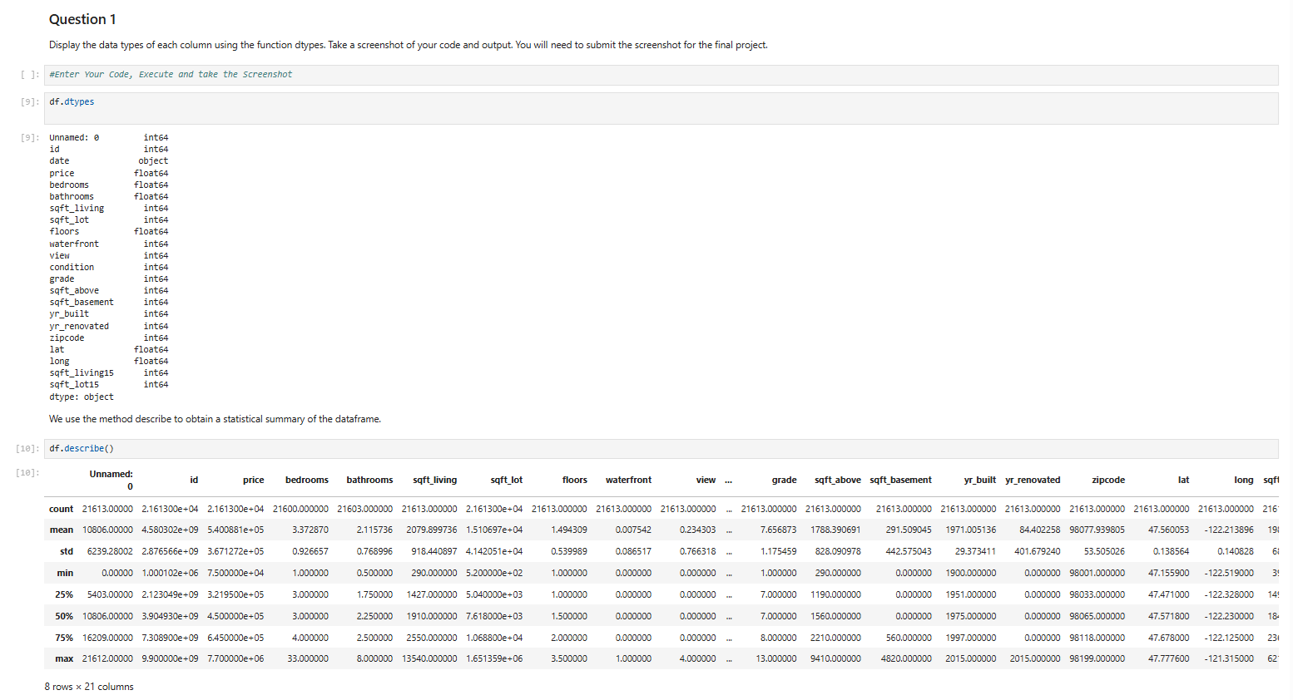

Slide 5
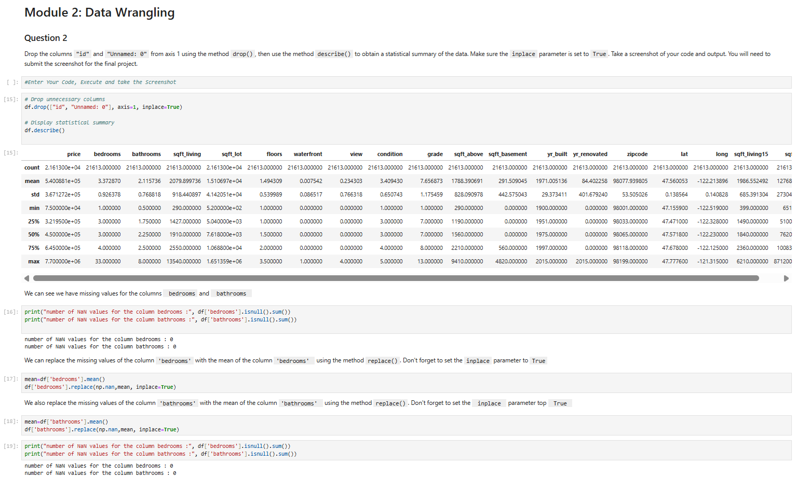

Slide 6
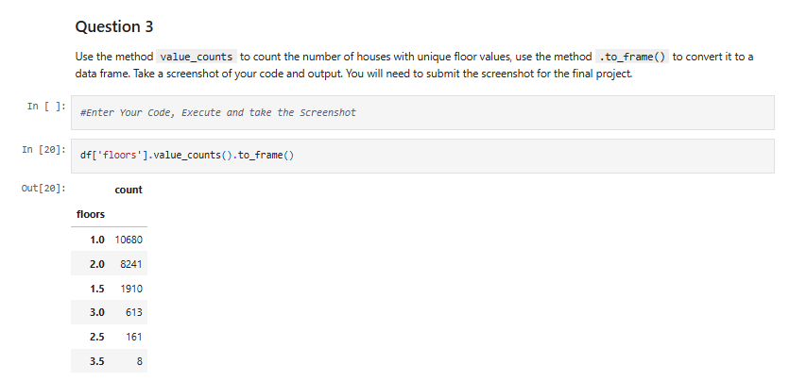

Slide 7
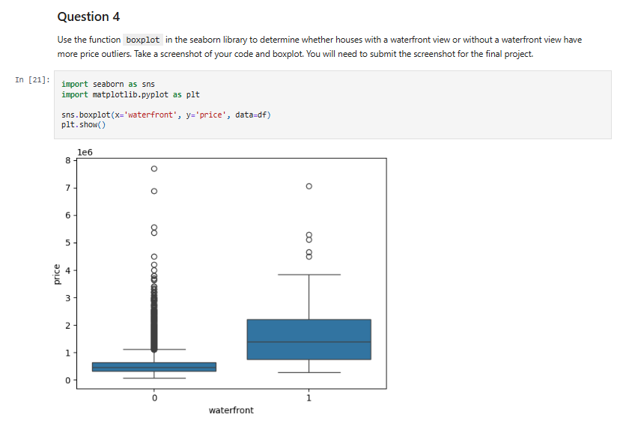

Slide 8
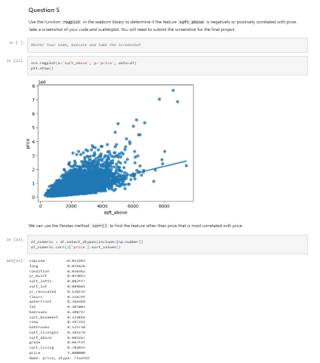

Slide 9
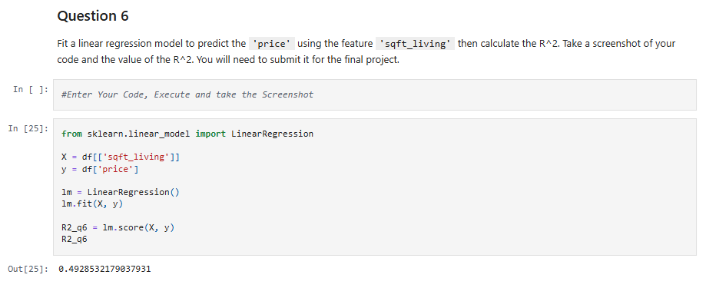

Slide 10
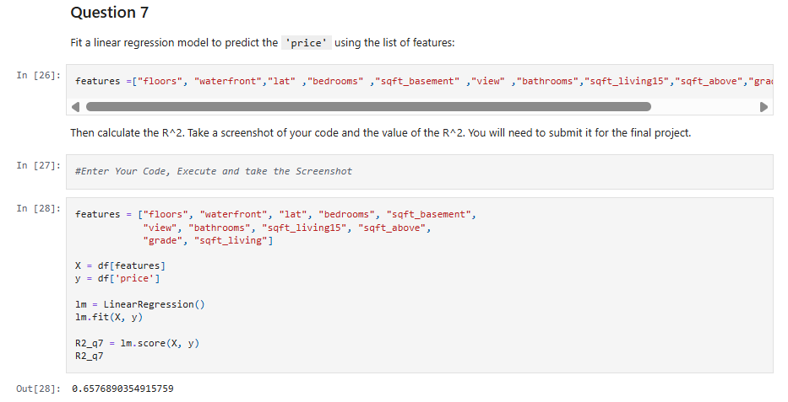

Slide 11
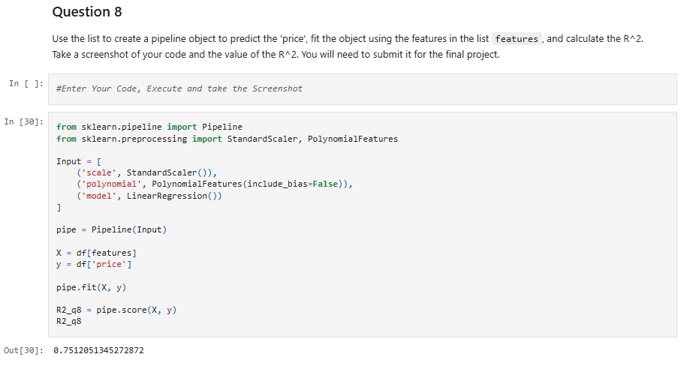

Slide 12
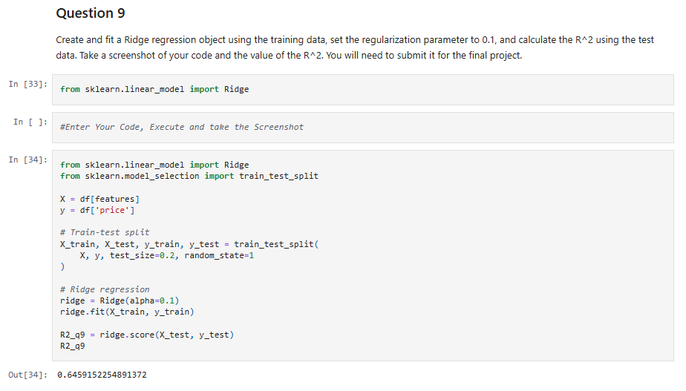

Slide 13
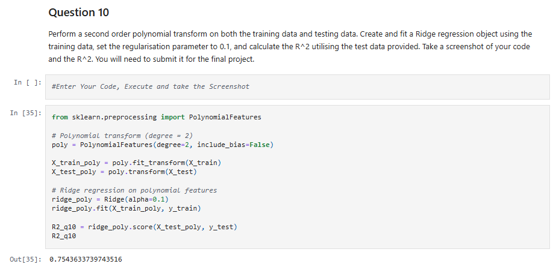

Slide 14
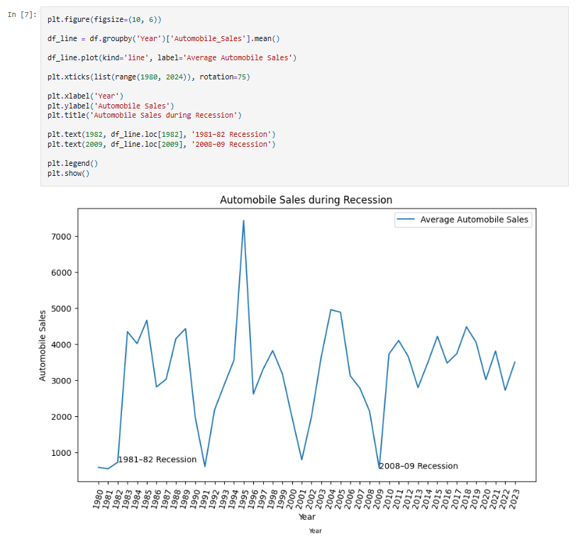

Slide 15
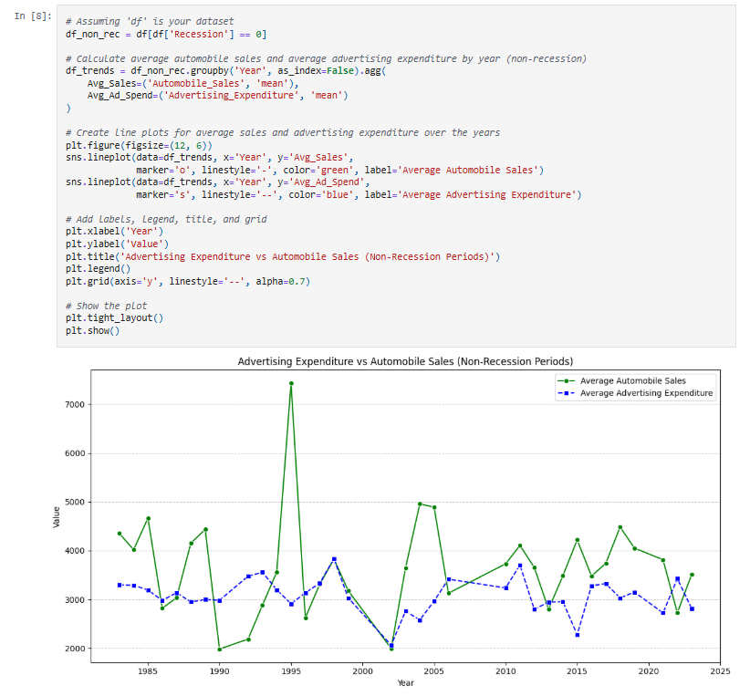

Slide 16
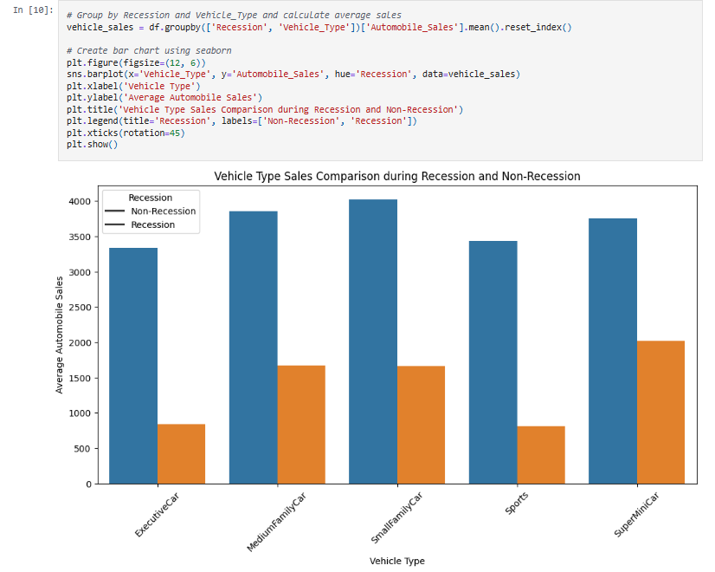

Slide 17
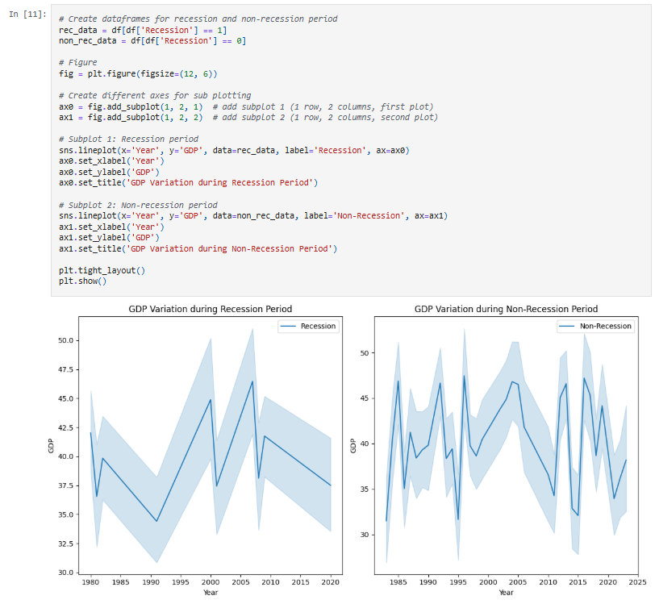

Slide 18
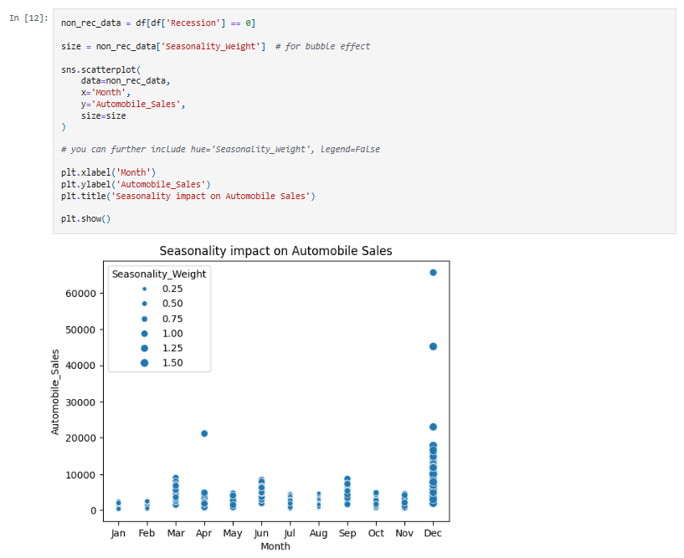

Slide 19
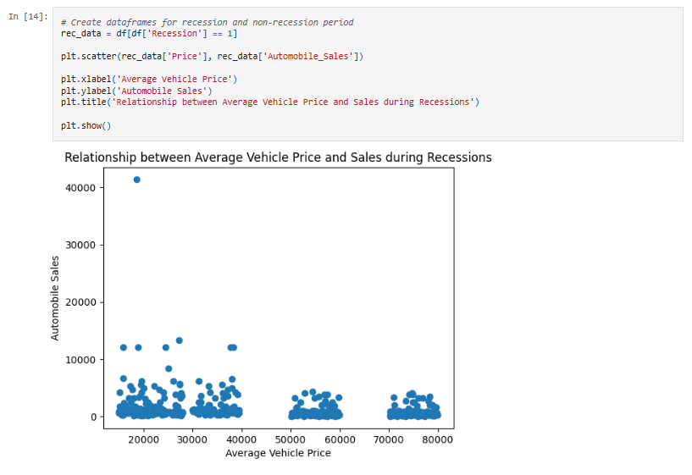

Slide 20
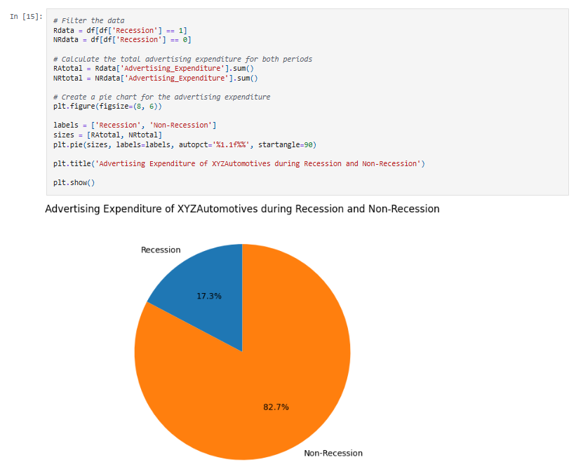

Slide 21
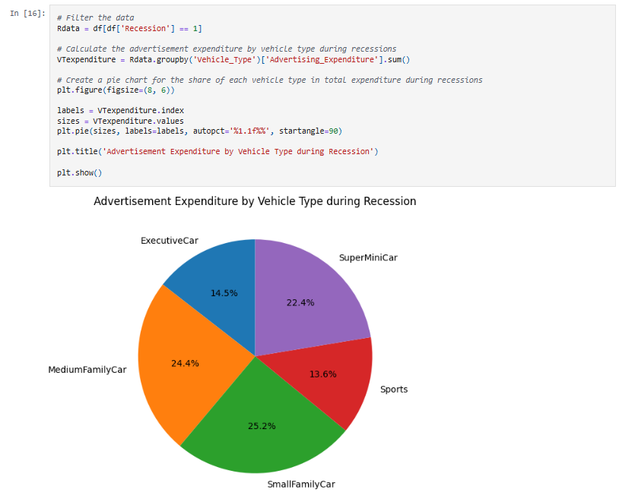

Slide 22
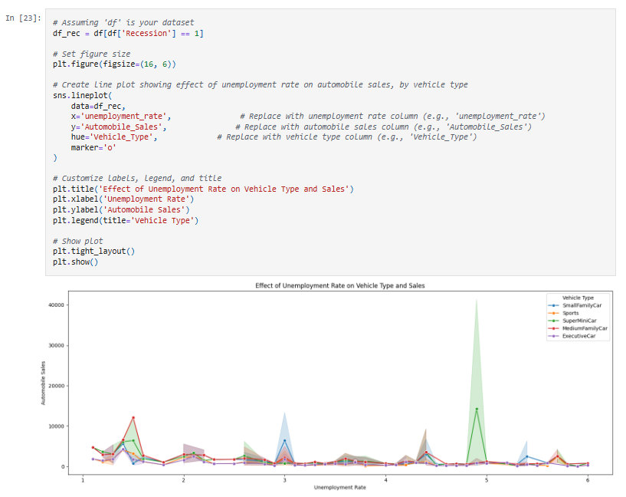

Slide 23
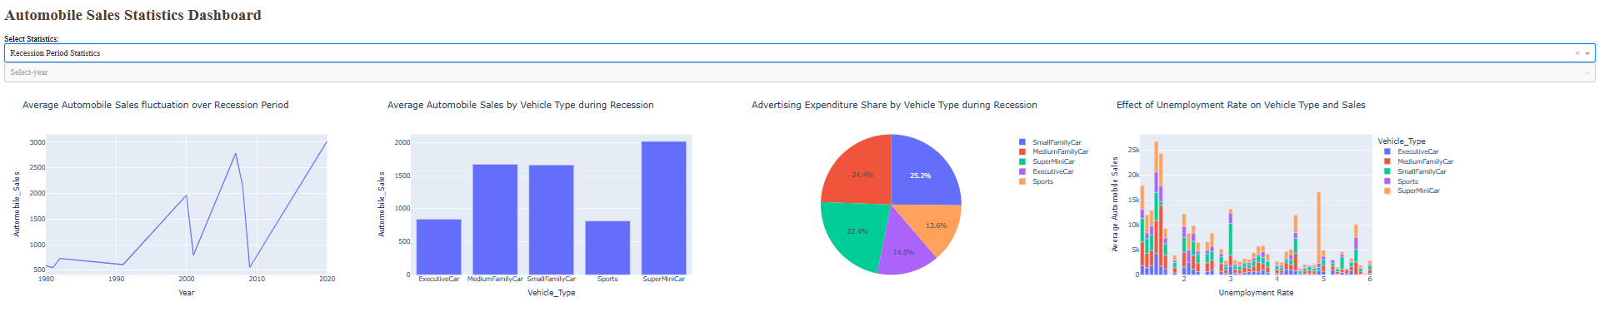
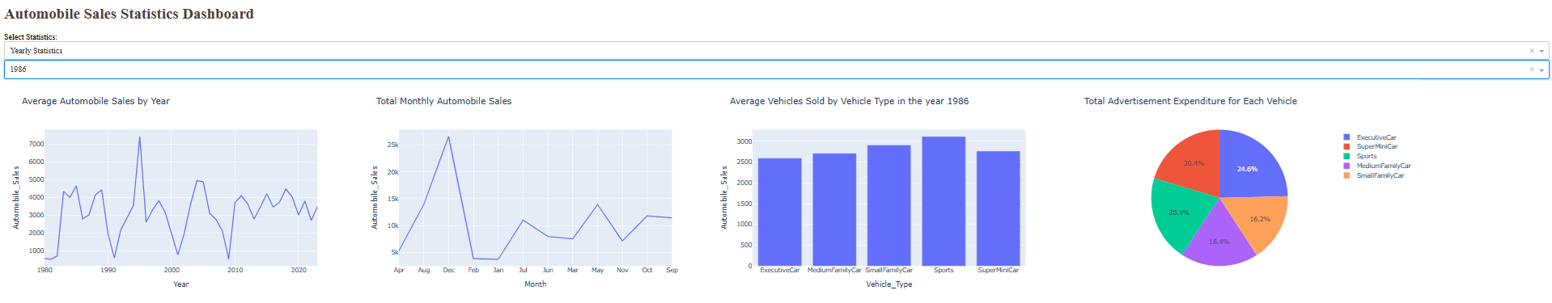

Slide 24
Conclusion
Looking back on my journey from student to data scientist through the IBM course, I realise that the transformation was about more than just learning technical skills. It was about developing a problem-solving mindset, embracing failure as part of the learning process, and building the confidence to tackle complex challenges. The IBM Data Science program gave me the foundation I needed, but it was my persistence, curiosity, and willingness to apply what I learned that truly made the difference. Today, as I continue to grow in this field, I'm grateful for that first step I took and excited about the endless possibilities that lie ahead. For anyone considering a similar path, my advice is simple: start learning, stay curious, and trust the process—the journey is absolutely worth it.

